Slide 1
Activity 02: Data Exploration
SISMID Lab
July 22 through July 24, 2026
A Human – AI Teaming Approach to Infectious Disease Modeling

Slide 2

General Housekeeping
Any slide with this icon contains the goals and
expected outputs for the activity. All outputs listed in
the tables on these slides should be uploaded to the
course GitHub repository for review.
Any slide with this icon indicates that it is time to complete a hands-on activity. Carefully follow the instructions provided, complete the required task, and verify your results.

Slide 3
Lab Timeline
We are here
Activity 1
Activity 2
Activity 3
Activity 4
Data Cleaning &
Visuals
Data
Exploration
Modeling & Forecasting
Evaluation
Activity 5 Incremental Revisions

Slide 4

Data Exploration & Visualization
Purpose: To explore the data before you model it and to write the rules that tell your agent what to plot and values to return.
What's different from Activity 1?
In Activity 1, the cleaning rules were provided for you.
In Activity 2, WE will write the rules.
Remember: rules doc → agents.md → scripts/02_data_explore.R

Slide 5
Activity Roadmap
The steps we will work through to explore and visualize the data.
1
2
3
4
Write the Rules
Build the Agent
Generate the Script
Run & Commit
Add a Visualization section to our rules document with precise rules for Q1–Q3.
Regenerate agents.md from your updated rules so the agent follows your new instructions.
Use agents.md to have Copilot (or AI of your choosing) write the scripts/02_data_explore.R script.
Run it, check the figures and peak_description.csv, then commit your results to GitHub.
Vague rules = vague output. Be precise about every detail.

Slide 6
Your Task
We will write visualization and analysis rules for the three questions (rules.md), then use them to generate the agent, the 02_data_explore.R script, and its figures and peak table.
Activity Output | Description
rules.md | Visualization rules for Q1–Q3 — plot types, axes, titles, colors, annotations, and output file names.
agents.md | Regenerated from your updated rules so the agent follows your new instructions.
scripts/02_data_explore.R | The R code Copilot (or AI of your choosing) writes from the agent to build the figures and the peak table.
figures + peak_description.csv | The finished outputs: national_trend.png, seasonal_comparison.png, and peak_description.csv.

Slide 7
Task 1 (Q1): National Trend over Time Visualization

Slide 8
Q1
Q1: National Trend over Time Visualization
Plot all data available from the previous activity. As a reminder, this includes counts of total influenza admissions for the entire United States from 2020 onward obtained from the CDC(NHSN) data set.
Highlight the 2025-2026 season with a gray shaded bar.
Ensure that the figure is publication-ready (i.e., cleaned up) and is saved in the correct folder as national_trend.png.

Slide 9
Writing the Visualization Rules
The rules should be specific enough that someone (or an AI) could produce the plot without asking any follow-up questions.
Things to think about:
Element | Description
Plot type | line chart, bar chart, scatter, etc.
X-Axis and Y-Axis | variable, label text, date format, start at zero?
Title | exact title text for the figure
Colors and highlights | line color, shading, annotation colors
Annotations and markers | peak markers, reference lines, text labels
Output file name | output/figures/02_data_explore/national_trend.png

Slide 10
Key Definition: What Is a "Season"?
We'll need this definition in the rules, so the agent knows how to identify season boundaries.
Influenza Season Boundaries
Time span: MMWR week 40 (≈ early October) through week 20 (≈ mid-May) of the next year. A season spans two calendar years and is named for both — e.g. 2025–26.
Season start: First calendar date of first year with Epiweek = 40. This is a fixed calendar week, the same every season, so the agent sets it directly rather than detecting it from the data. Please account for any leap years in this determination.
Season end: Earliest calendar date in the second year with Epiweek = 20.
(CDC, Purpose & Methods, 2025)
Notes:
CDC. (2025, December 2). U.S. Influenza Surveillance: Purpose and Methods. FluView. https://www.cdc.gov/fluview/overview/index.html
- Current Season: `2025-26`
- Season Start: first calendar date in the first year with epiweek == 40. This is a fixed calendar week and should be the same every season. Please account for any leap years in this determination as well.
- Season End: earliest calendar date in the second year with epiweek == 20.

Slide 11
Season-to-Date Mapping Note
When mapping calendar dates to MMWR epi-weeks, handle week numbers that fall in early January (for example epi-week 53) by using the calendar month to assign the season start year. Concretely, if a date's epiweek is >= 40 but its calendar month is January–August, attribute that date to the previous year's season (i.e., season_start_year = year - 1).
Hint: When specifying the season definition in the rules, copy-and- paste this directly in with the other specifications (previous slide).

Slide 12
Now it’s your turn!
We will work through the following steps together to add the next section to our rules.md document and obtain Q1.
1
Create the # Visualizations section header in rules.md, and under that the ## National Plot header.
Write detailed rules to obtain the visual for Q1. Make sure to specify input data details, season definitions, plot types, axes, colors, annotations, file names, etc. (vague rules = vague output).
2
3
Regenerate agents.md from your updated rules document
4
Use the agents.md file and Copilot (or AI of your choosing) to generate scripts/02_data_explore.R. Run the script and check the output.

Slide 13
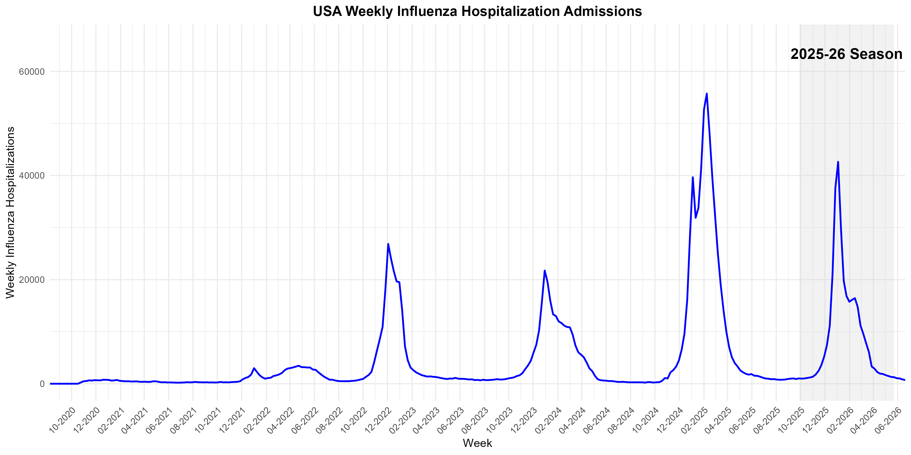
national_trend.png

Slide 14
Task 2 (Q2): Season Comparison

Slide 15
Q1
Q2: Season Comparison
Plot all data available from the previous activity. Unlike Q1, we want to overlay past seasons to compare trajectories. Therefore, we will need to standardize dates across seasons (example on next slide).
Change the formatting of the lines so that the current season (2025-2026) stands out.
Ensure that the figure is publication-ready (i.e., cleaned up) and is saved in the correct folder as seasonal_comparison.png.

Slide 16
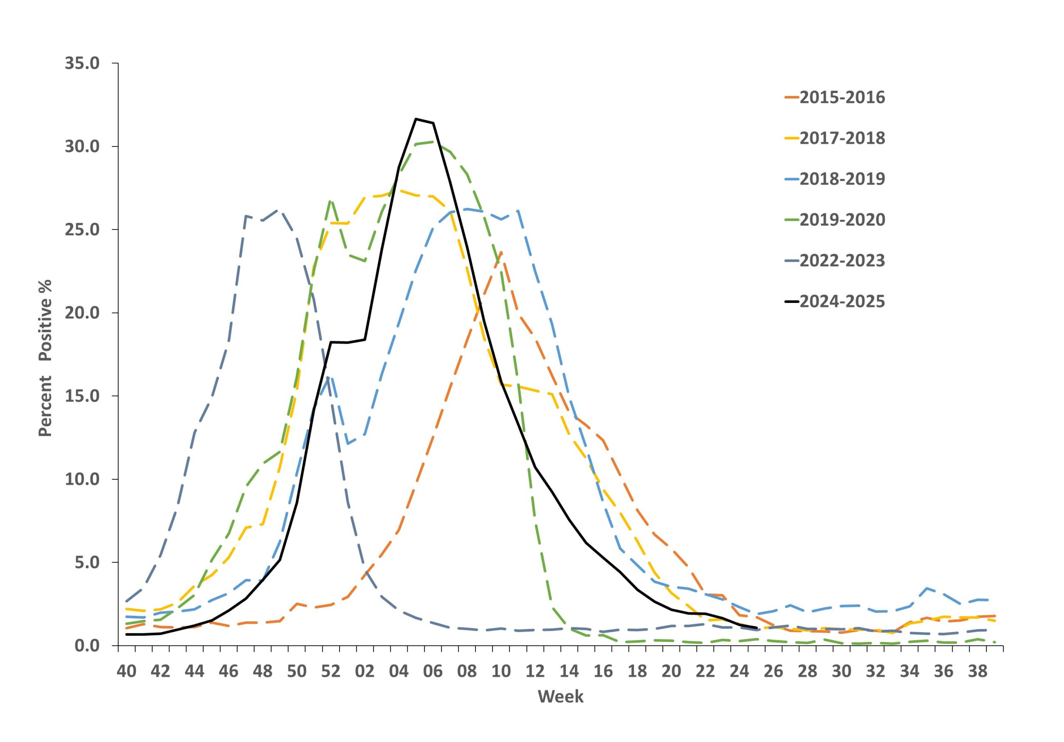
Example: Seasonal Comparison Plot
Style reference only.
(CDC, Influenza Activity in the US, 2026)
Notes:
CDC. (2026, May 5). Influenza Activity in the United States during the 2024–25 Season and Composition of the 2025–26 Influenza Vaccine. Influenza (Flu). https://www.cdc.gov/flu/whats-new/2025-2026-influenza-activity.html

Slide 17
Writing the Visualization Rules
The rules should be specific enough that someone (or an AI) could produce the plot without asking any follow-up questions.
Things to think about:
Element | Description
Plot type | line chart, bar chart, scatter, etc.
Legend | Legend title, item labels, etc.
X-Axis and Y-Axis | variable, label text, date format, start at zero?
Title | exact title text for the figure
Colors and highlights | line color, shading, annotation colors
Annotations and markers | peak markers, reference lines, text labels
Output file name | output/figures/02_data_explore/seasonal_comparison.png

Slide 18
Key Definition: What Is a "Season"?
We'll need this definition in the rules, so the agent knows how to identify season boundaries.
Influenza Season Boundaries
Time span: MMWR week 40 (≈ early October) through week 20 (≈ mid-May) of the next year. A season spans two calendar years and is named for both — e.g. 2025–26.
Season start: First calendar date of first year with Epiweek = 40. This is a fixed calendar week, the same every season, so the agent sets it directly rather than detecting it from the data. Please account for any leap years in this determination.
Season end: Earliest calendar date in the second year with Epiweek = 20.
(CDC, Purpose & Methods, 2025)
Notes:
CDC. (2025, December 2). U.S. Influenza Surveillance: Purpose and Methods. FluView. https://www.cdc.gov/fluview/overview/index.html
- Current Season: `2025-26`
- Season Start: first calendar date in the first year with epiweek == 40. This is a fixed calendar week and should be the same every season. Please account for any leap years in this determination as well.
- Season End: earliest calendar date in the second year with epiweek == 20.

Slide 19
Plotting Note: The seasonal plot must present the full season chronologically by plotting MMWR weeks 40–53 followed by weeks 1–20 (so weeks 1–20 appear after 40–53 on the x-axis). The plotting implementation must ensure weeks 1–20 are not dropped and are positioned after weeks 40–53 so the full season displays continuously.
Hint: When specifying the season definition in the rules, copy-and- paste this directly in with the other specifications (previous slide).

Slide 20
Now it’s your turn!
We will work through the following steps together to add the next section to our rules.md document and obtain Q2.
1
Create the ## Season Plot section header under
# Visualizations header in rules.md.
Write detailed rules to obtain the visual for Q2. Make sure to specify plot types, axes, colors, annotations, file names, etc. (vague rules = vague output).
2
3
Regenerate agents.md from your updated rules document
4
Use the agents.md file and Copilot (or AI of your choosing) to update scripts/02_data_explore.R. Run the script and check the output.

Slide 21
Now it’s your turn!
Now, on your own, update your rules to make the following changes to your figure and upload the final outputs to the course GitHub.
1
Increase the thickness of the current season plotted line and change the color of the line to blue.
Change the non-season plotted lines style. For example, if they are solid lines change it to dashed; if they are dashed, change it to solid.
2
3
Ensure that the x-axis label is “Week of Season” and the y-axis to “Weekly Total Influenza Admissions (USA)”.
4
Upload the resulting rules document (Hint: Prompt Copilot, or AI of your choosing, to update the rules document with the new changes), agents.md, script and figure to GitHub. The figure should be named seasonal_comparison.png.

Slide 22
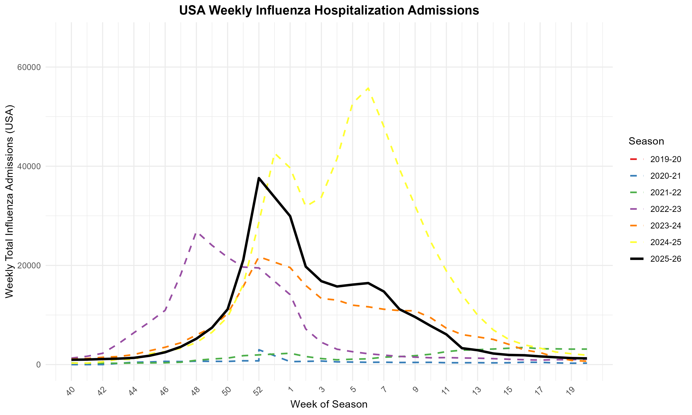
seasonal_comparison.png

Slide 23
Task 3 (Q3): Peak Analysis (2025-2026)

Slide 24
Q1
Q3: Peak Analysis (2025-2026)
Use the data created in Activity 1 to answer the following questions
about the current season. Unlike Q1 and Q2, you will write the rules and obtain a CSV rather than a figure.
When was the peak and how big was it?
When did the decline start?
When did the season start and end?

Slide 25
Data File Format
Element | Description
Output file name | output/data/02_data_explore/peak_description.csv
Columns & Order | Peak_Time, Peak_Intensity, Decline_Start, Season_Start, Season_End
Variable Type | Date (YYYY-MM-DD): Peak_Time, Decline_Start, Season_Start, Season_End Numeric: Peak_Intensity
The GitHub agent will check for these columns and file name upon submission. Please make sure to explicitly reference this structure as you develop the rules to answer the peak questions.
Notes:
When was the peak? Was there more than one? When did the decline start? When did the season start and end?

Slide 26
Key Definition: What Is a "Season"?
We'll need this definition in the rules, so the agent knows how to identify season boundaries.
Influenza Season Boundaries
Time span: MMWR week 40 (≈ early October) through week 20 (≈ mid-May) of the next year. A season spans two calendar years and is named for both — e.g. 2025–26.
Season start: First calendar date of first year with Epiweek = 40. This is a fixed calendar week, the same every season, so the agent sets it directly rather than detecting it from the data. Please account for any leap years in this determination.
Season end: Earliest calendar date in the second year with Epiweek = 20.
(CDC, Purpose & Methods, 2025)
Notes:
CDC. (2025, December 2). U.S. Influenza Surveillance: Purpose and Methods. FluView. https://www.cdc.gov/fluview/overview/index.html
- Current Season: `2025-26`
- Season Start: first calendar date in the first year with epiweek == 40. This is a fixed calendar week and should be the same every season. Please account for any leap years in this determination as well.
- Season End: earliest calendar date in the second year with epiweek == 20.

Slide 27
Implementation Note
When computing `season_start_year` for each `week`, use the calendar year of the date (`year(week)`) as the base year passed to the assignment logic — do not use the `MMWRyear` returned by `MMWRweek()` as the
base. This avoids mis-attribution when MMWR week numbers span calendar-year boundaries.
Hint: When specifying the season definition in the rules, copy-and- paste this directly in with the other specifications (previous slide).

Slide 28
Now it’s your turn!
On your own, go through the following steps to add the next section to the rules.md document and obtain the answers for Q3. Once you are finished, upload your results to GitHub.
1
Create the ## Peak Analysis section header under the
## Season Plot header in rules.md.
Write detailed rules to obtain the CSV for Q3. Make sure to include where to call the data from, where to save, column headers and types, definition of a peak, etc.
2
3
Regenerate agents.md from your updated rules document
4
Use the agents.md file and Copilot (or AI of your choosing) to update scripts/02_data_explore.R. Run the script and check the output.

Slide 29
Remember, vague rules will result in vague output. Be precise about every detail!

Slide 30
peak_description.csv
Variable | Value
Peak_Time | 2026-01-03
Peak_Intensity | 42,634
Decline_Start | 2026-01-10
Season_Start | 2025-09-28
Season_End | 2026-05-17

